Slide 1
TELANGANA Excise department

Slide 2
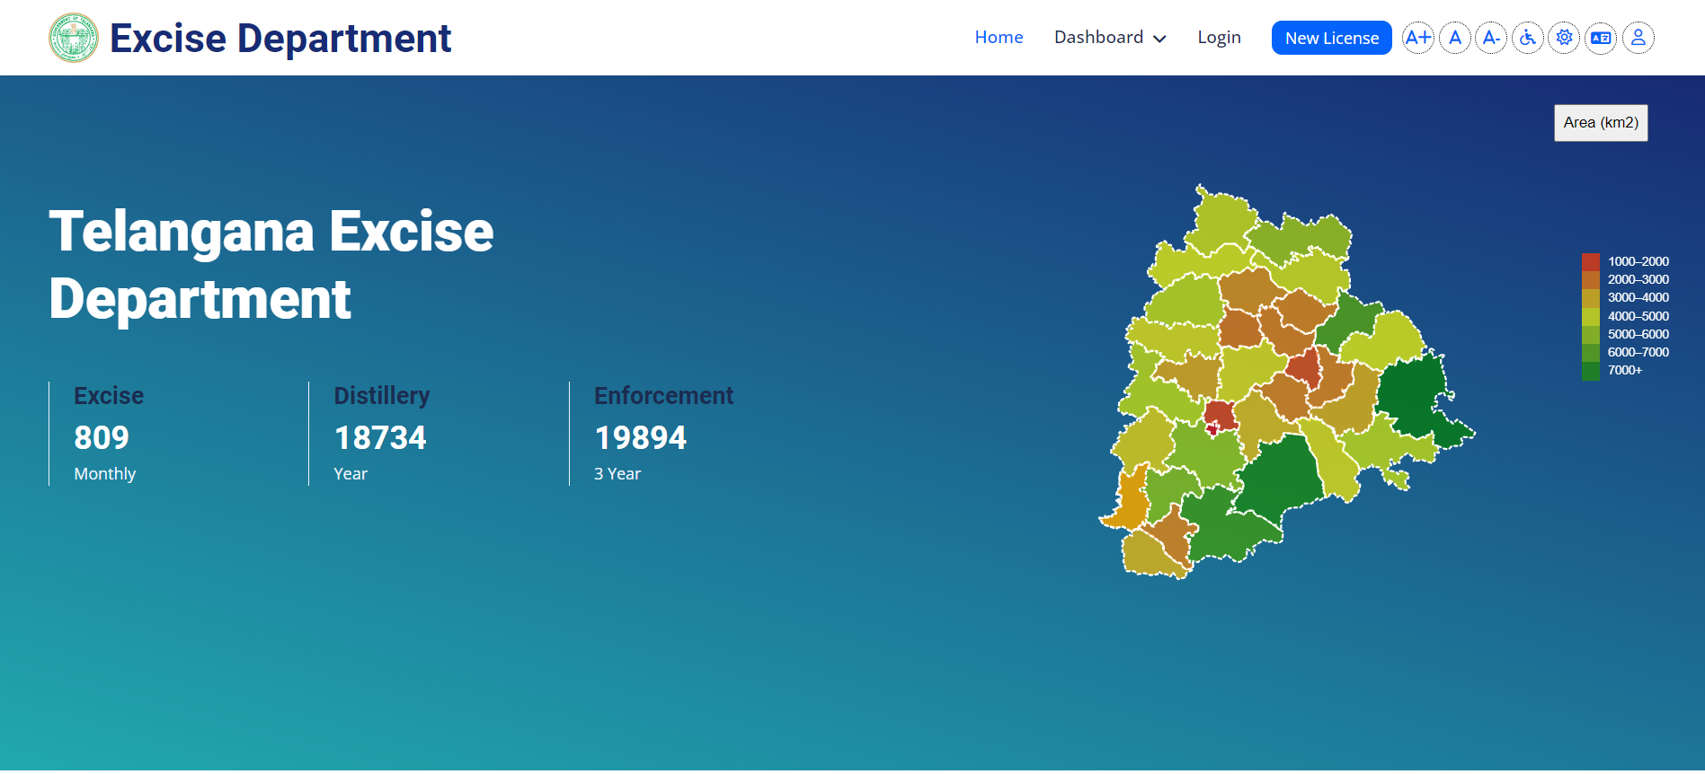
Dashboard contain

Slide 3
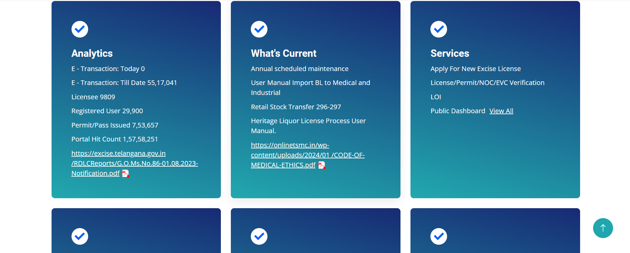
Excise Insights

Slide 4
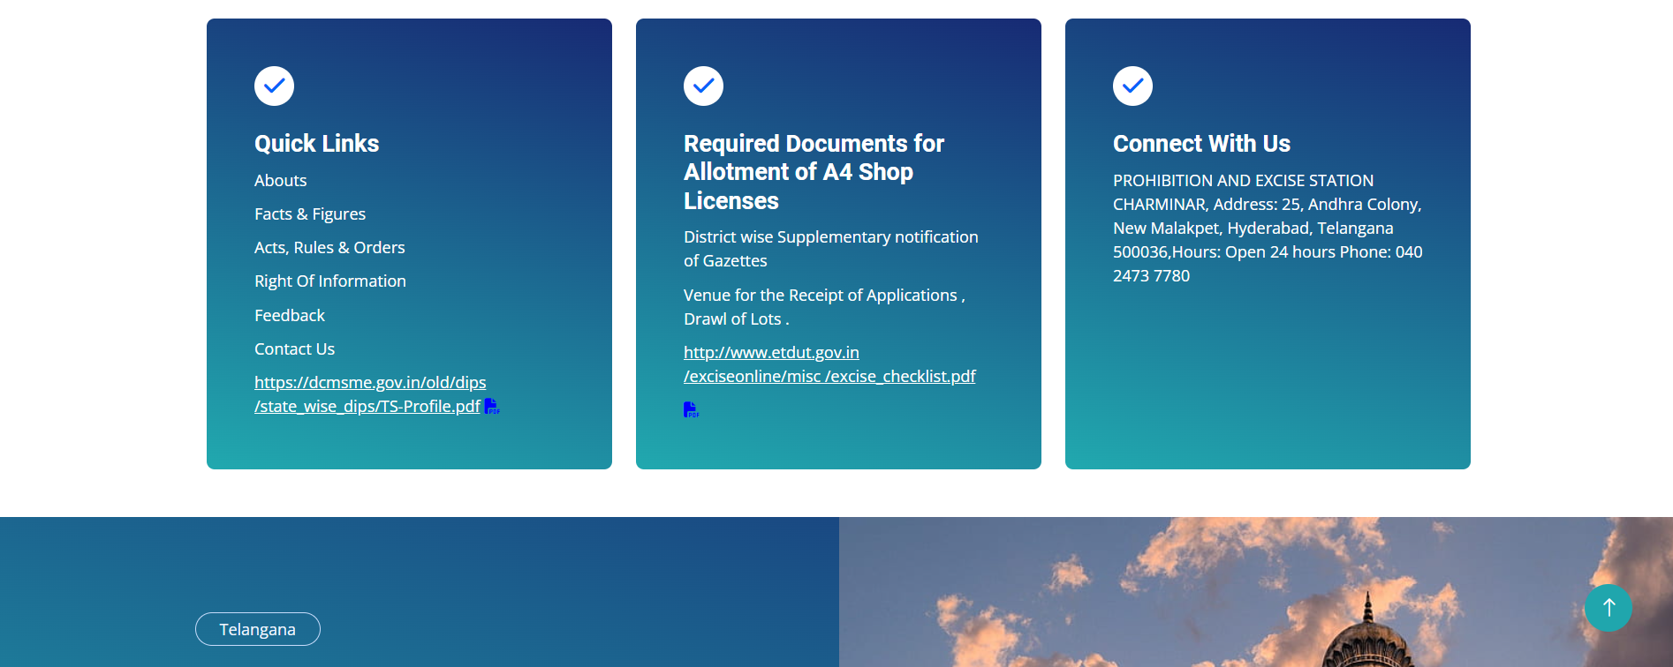
License Guide

Slide 5
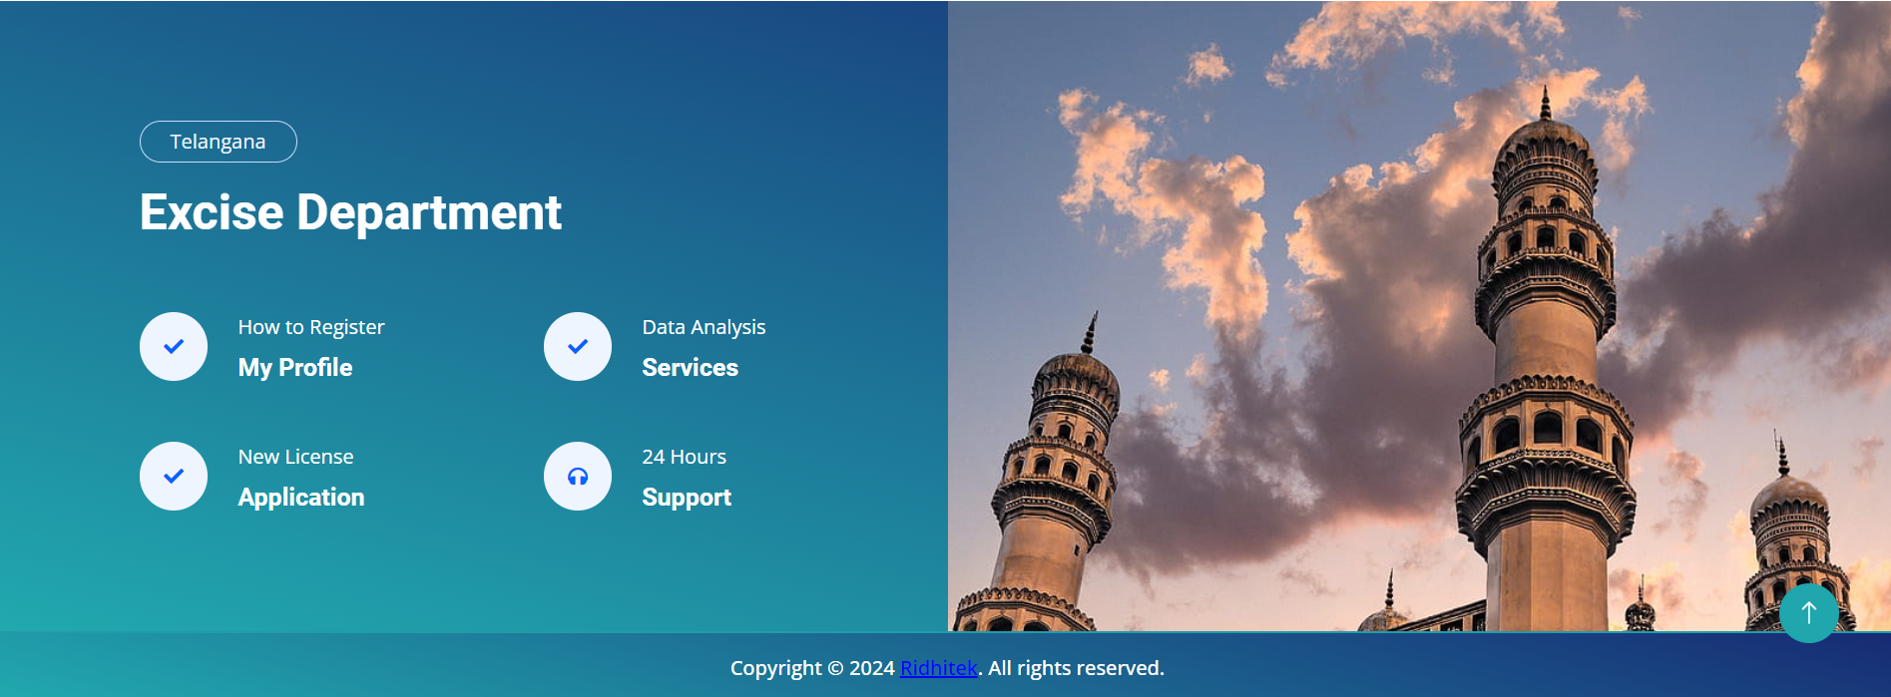
Telangana Excise
Department

Slide 6
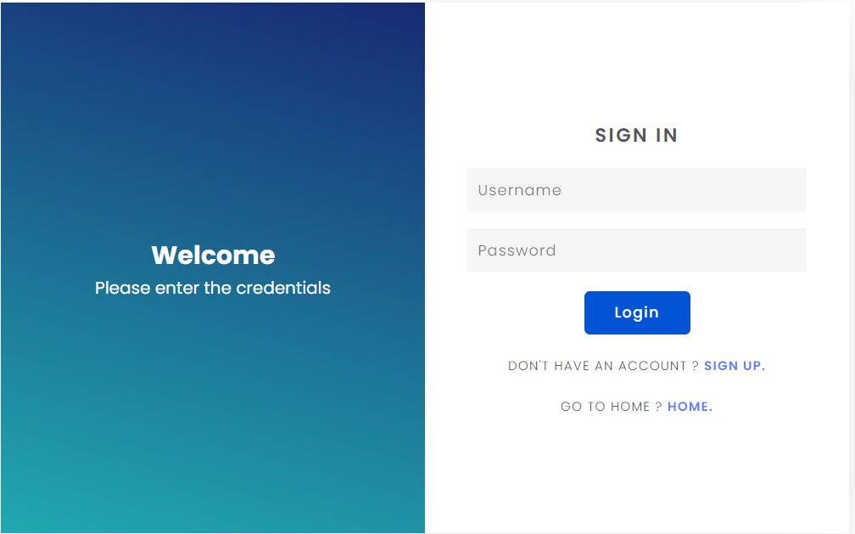
Excise Portal

Slide 7
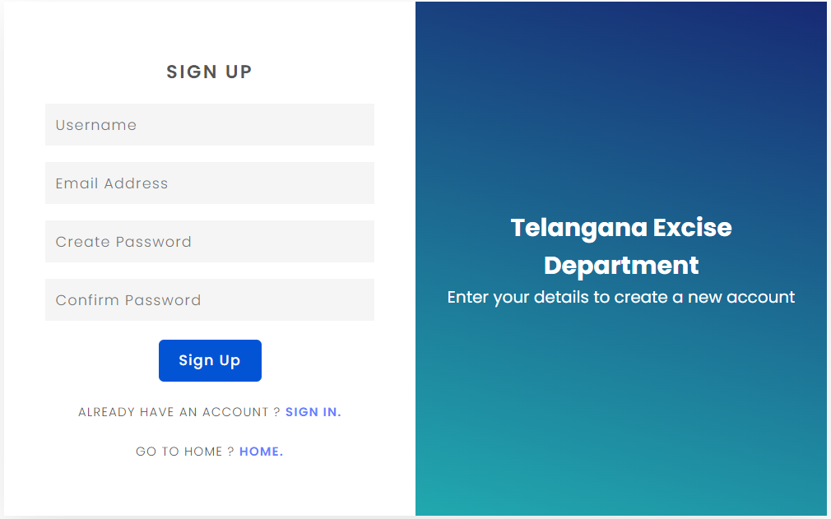
Welcome to excise
Portal

Slide 8
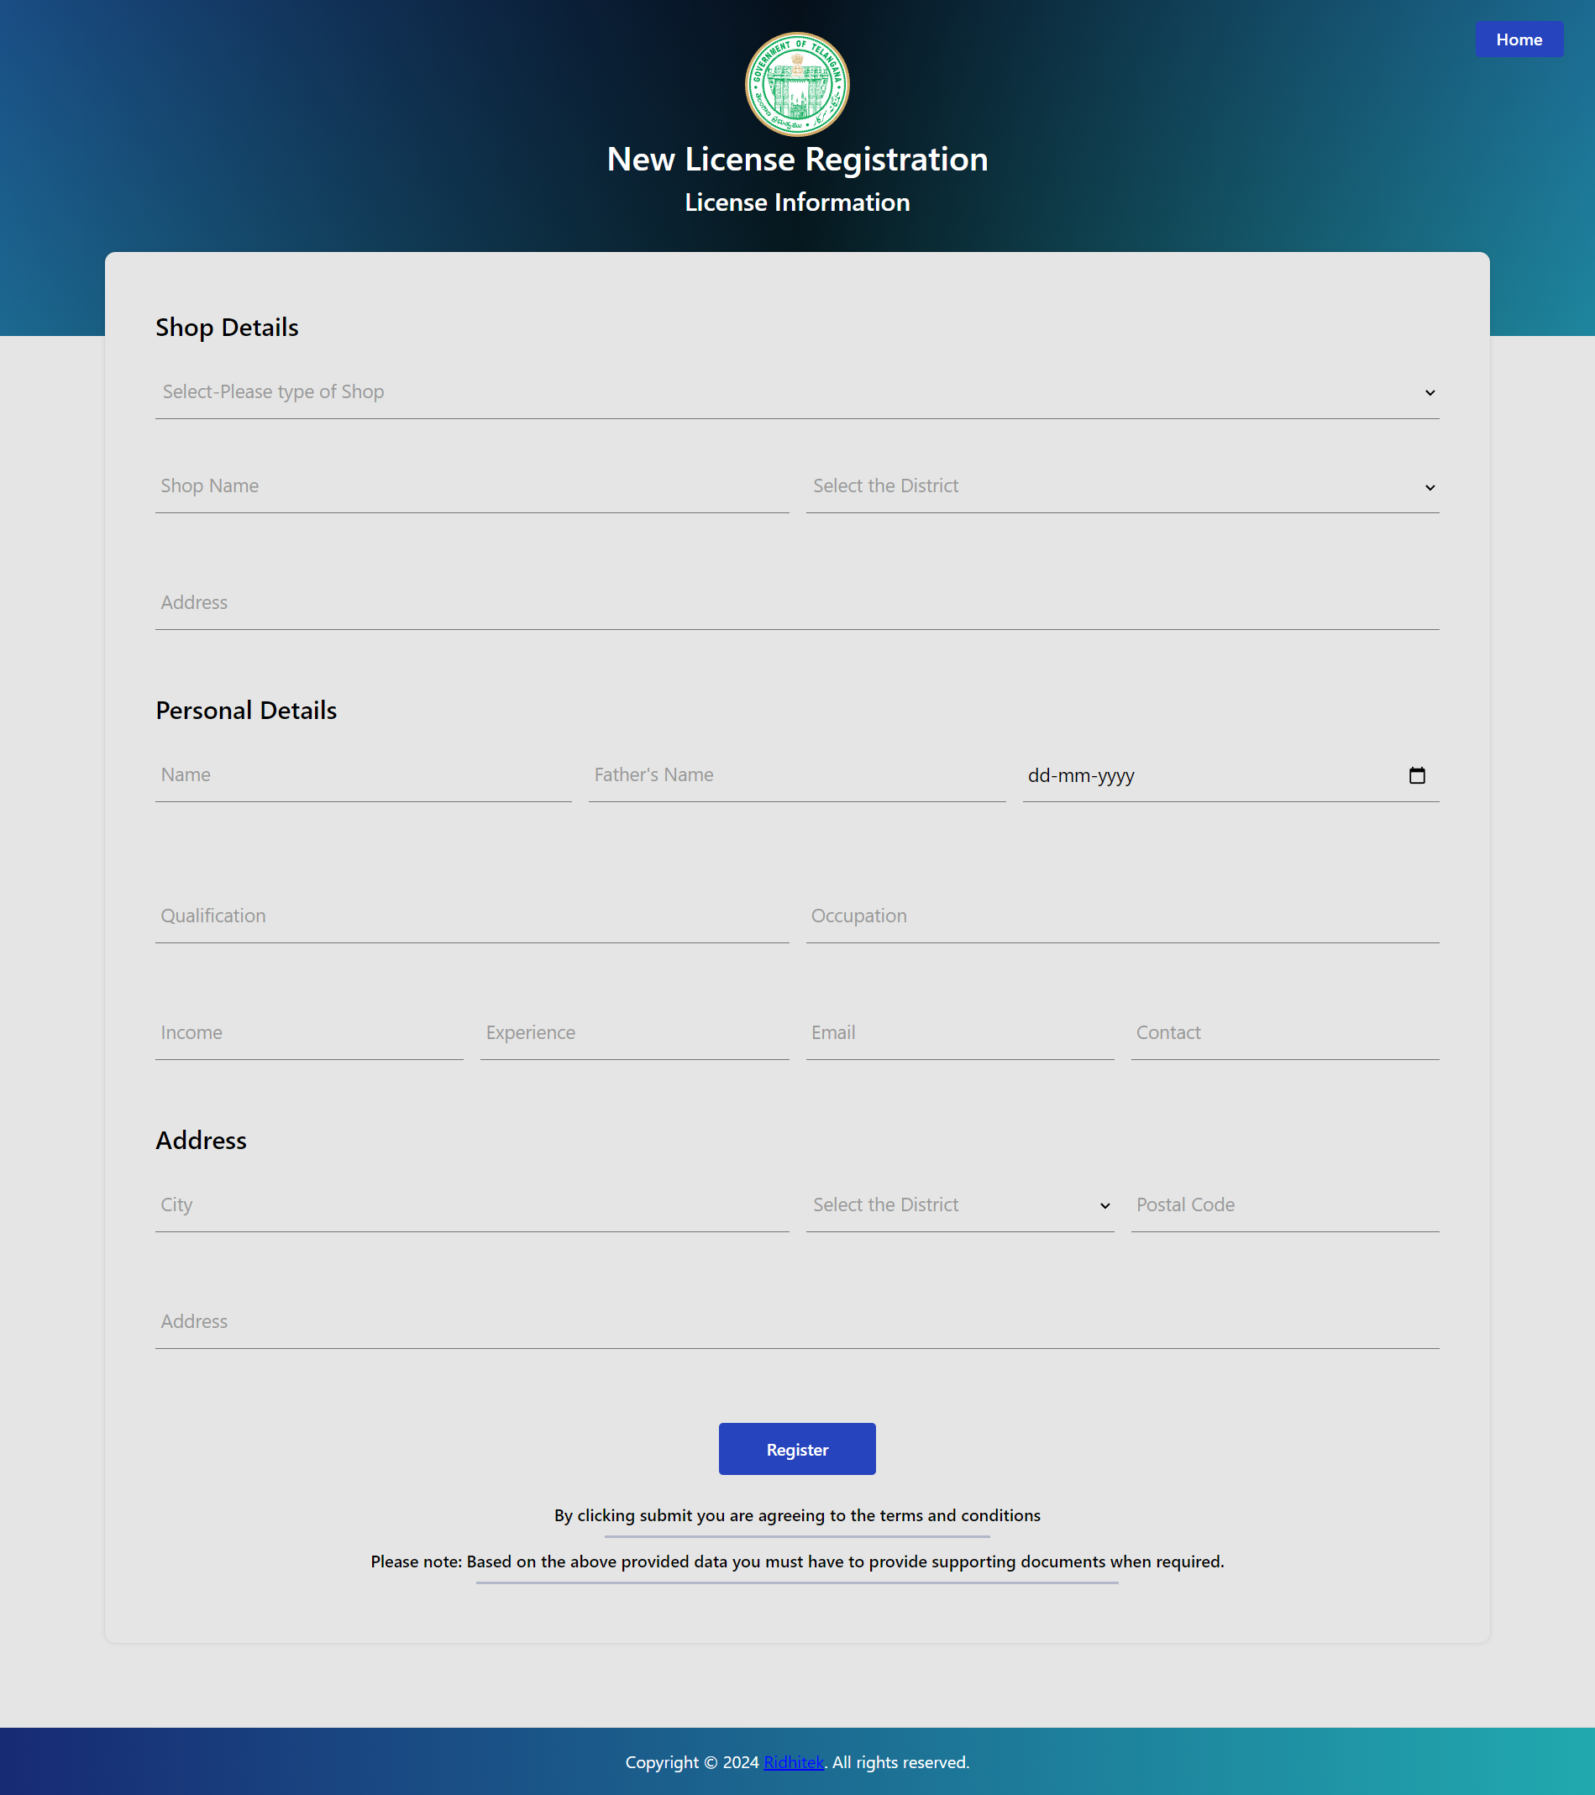
New license
Registration

Slide 9
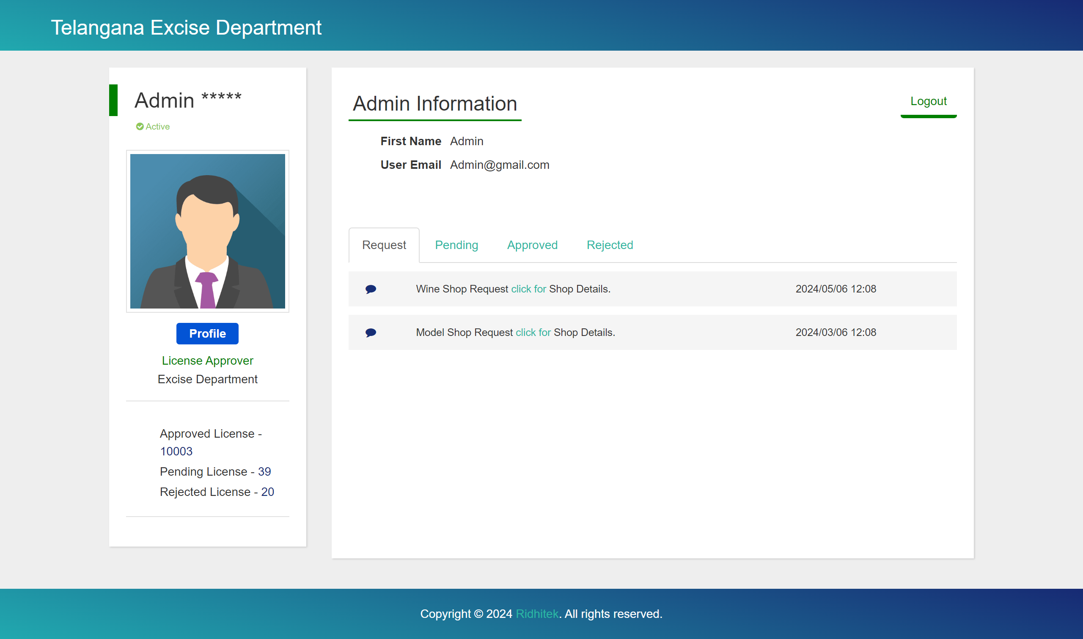
Admin Profile
Information

Slide 10
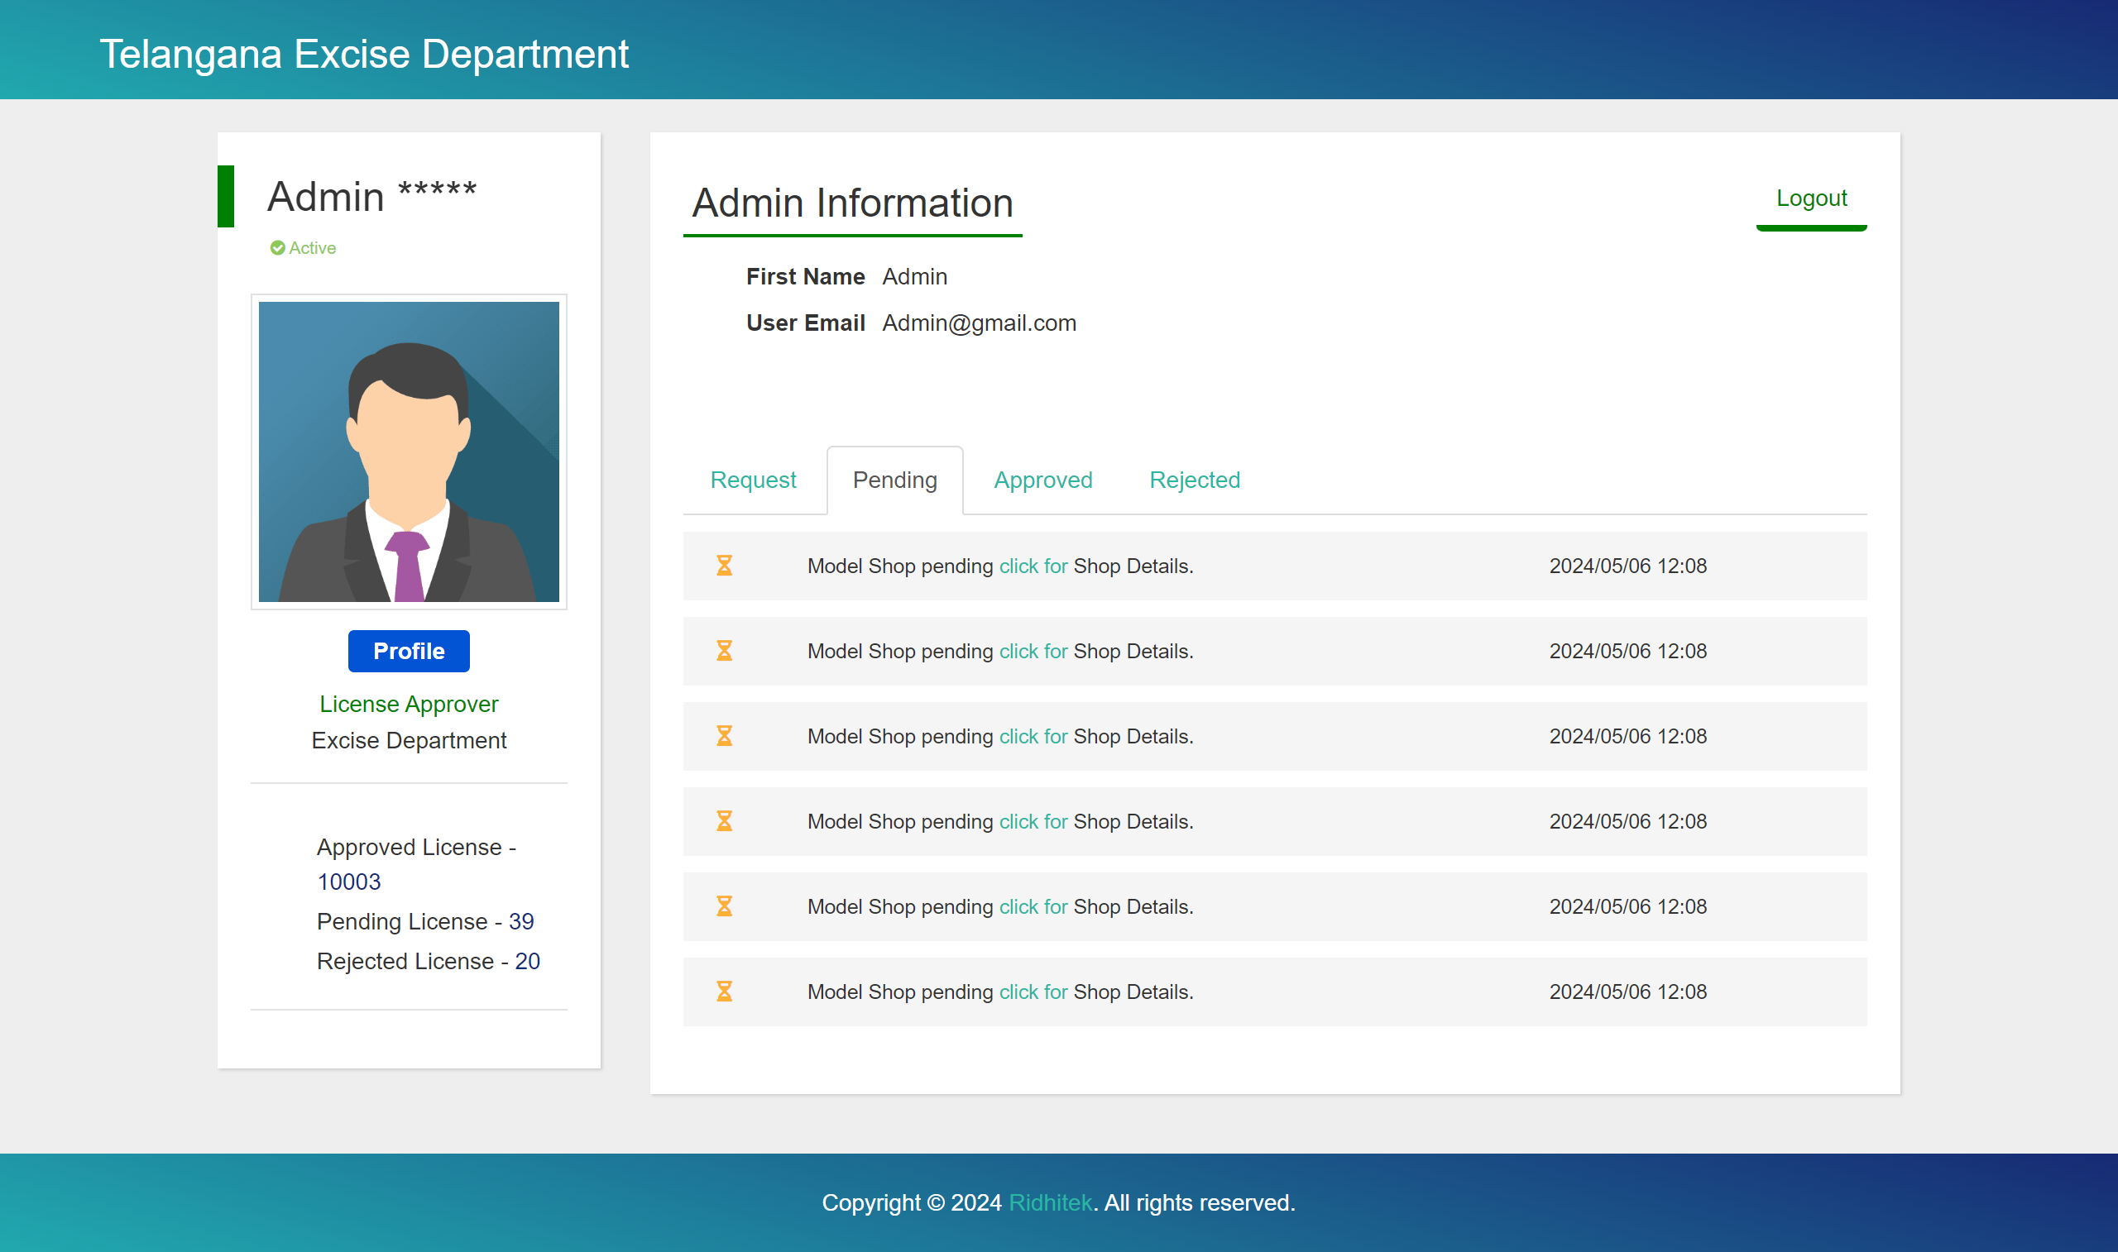
Admin pending
Status

Slide 11
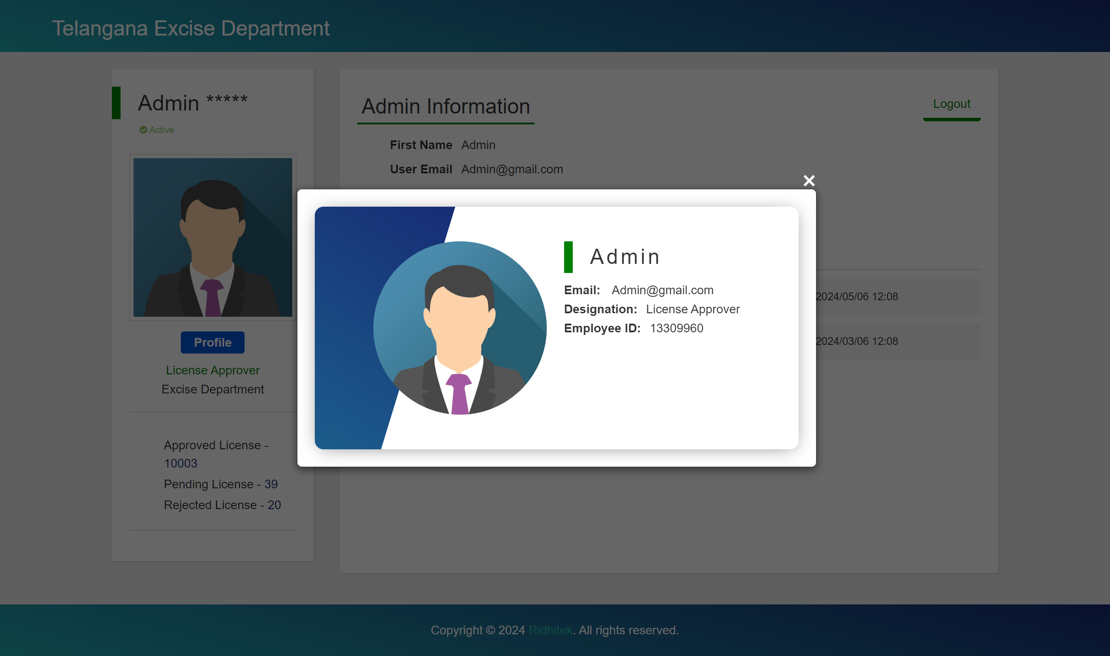
Admin profile

Slide 12
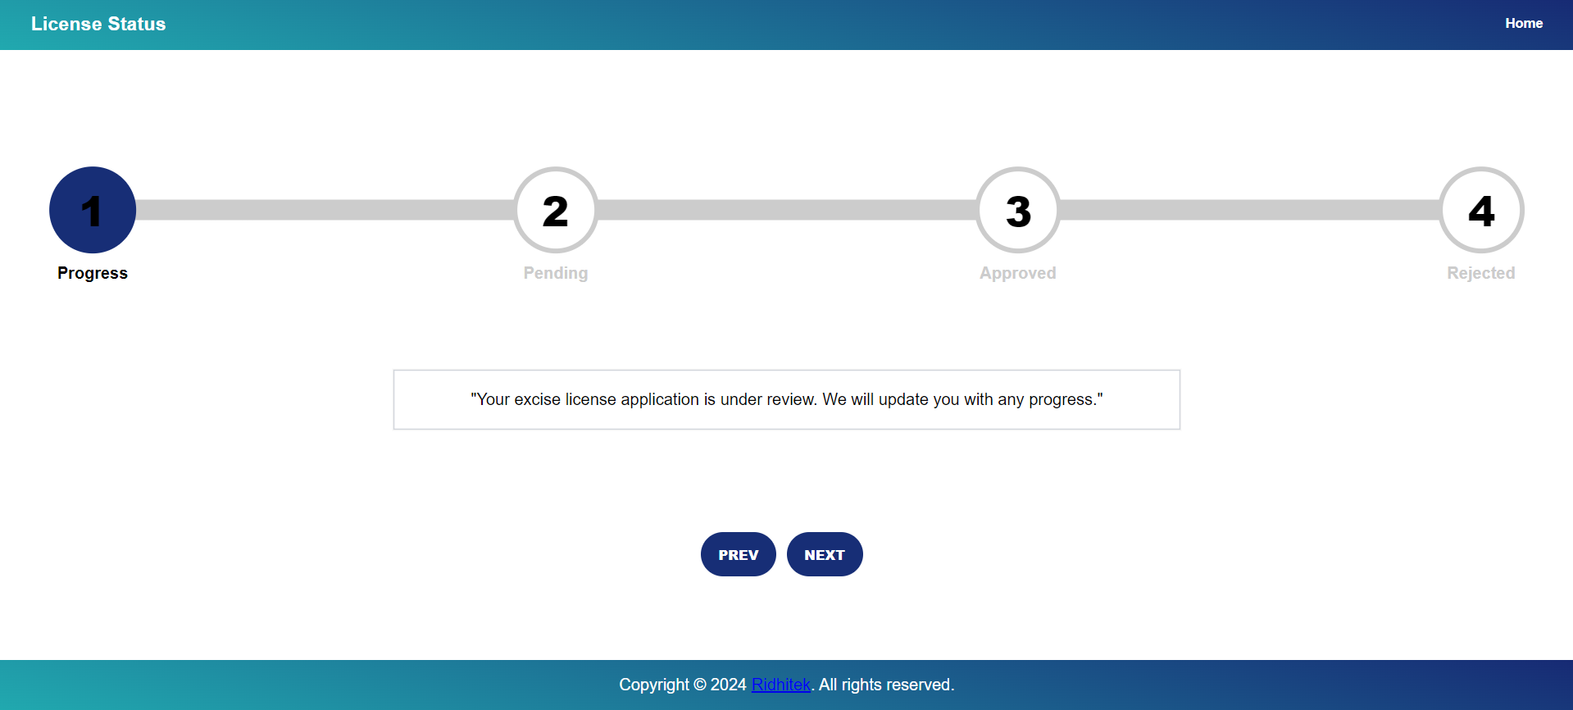
License status

Slide 13
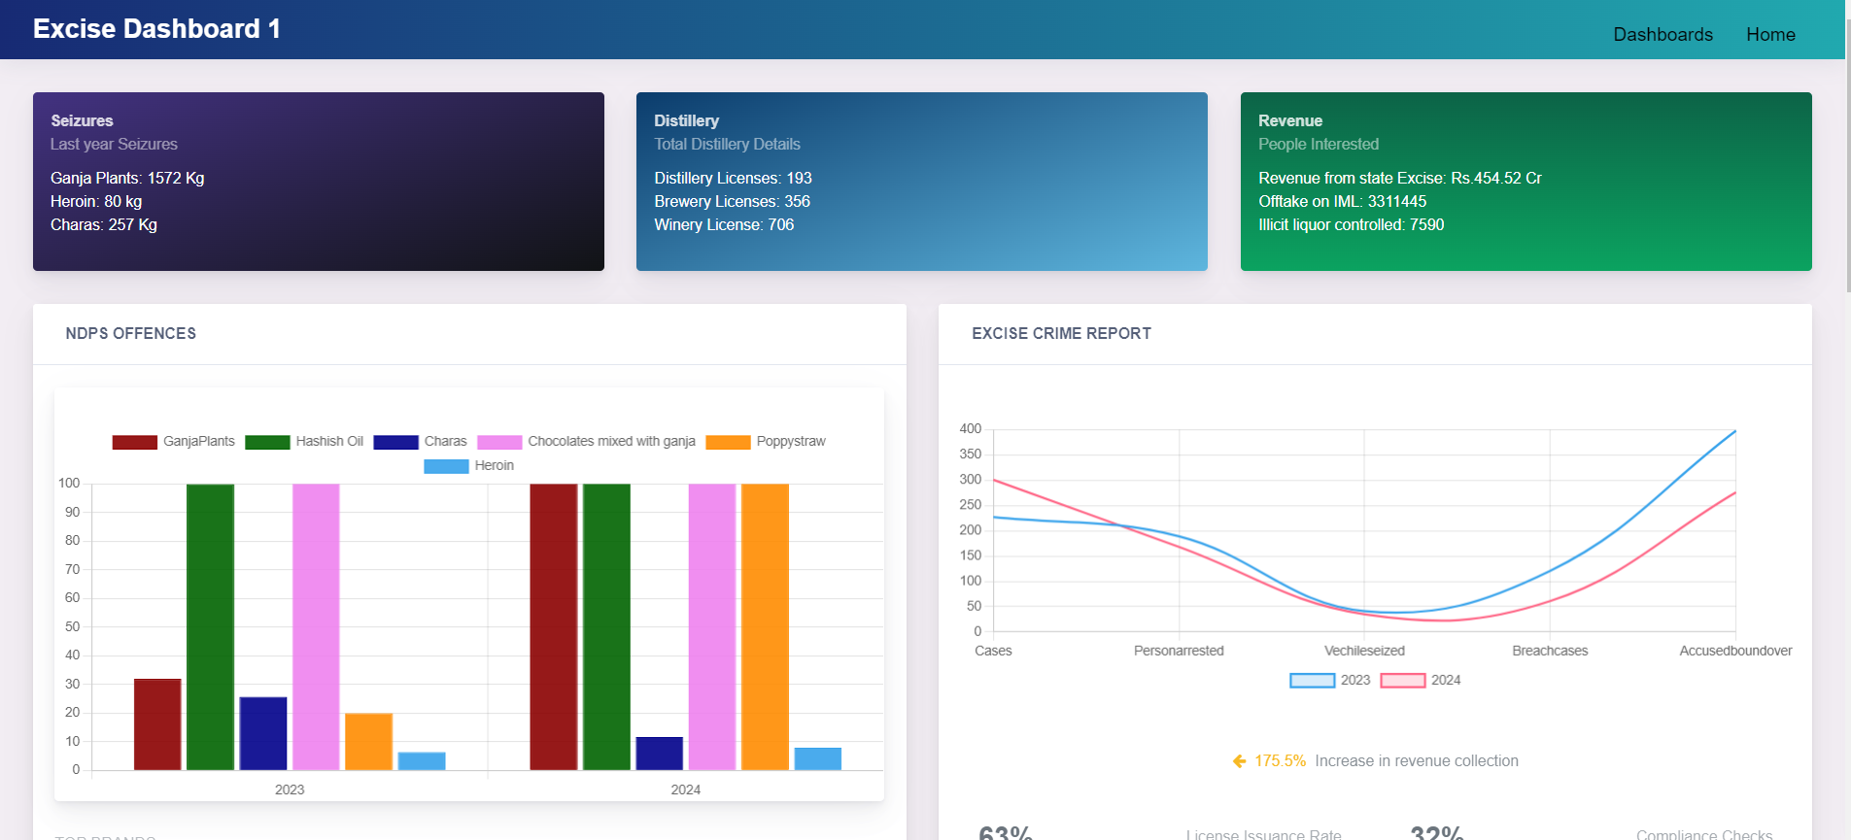
Excise Dashboard

Slide 14
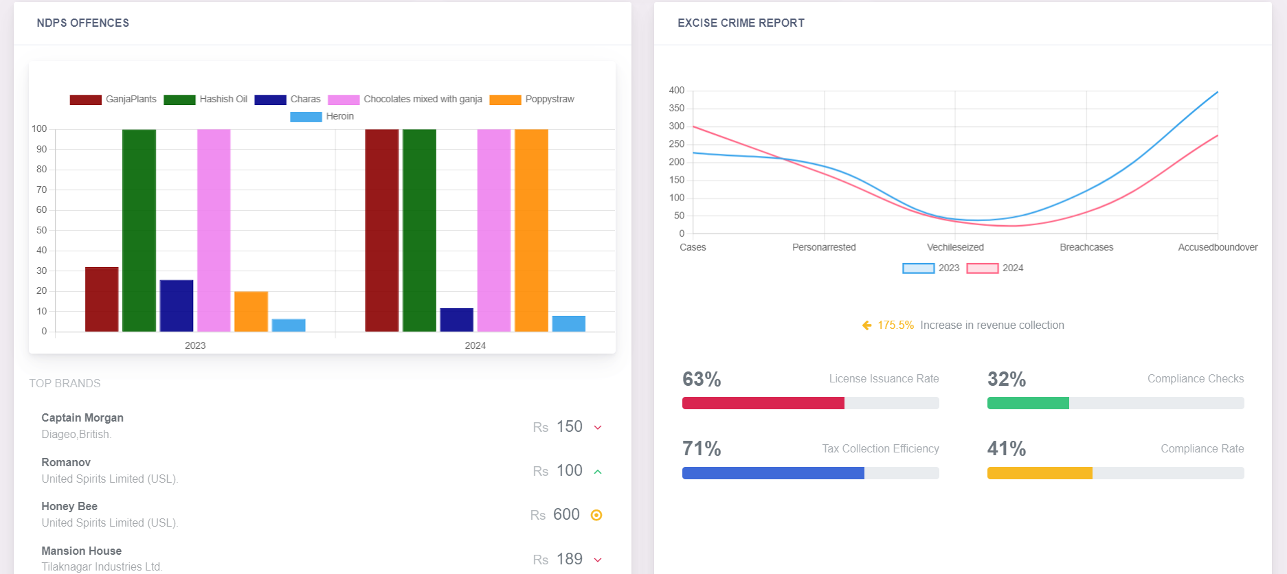
Crime and revenue
dashboard

Slide 15
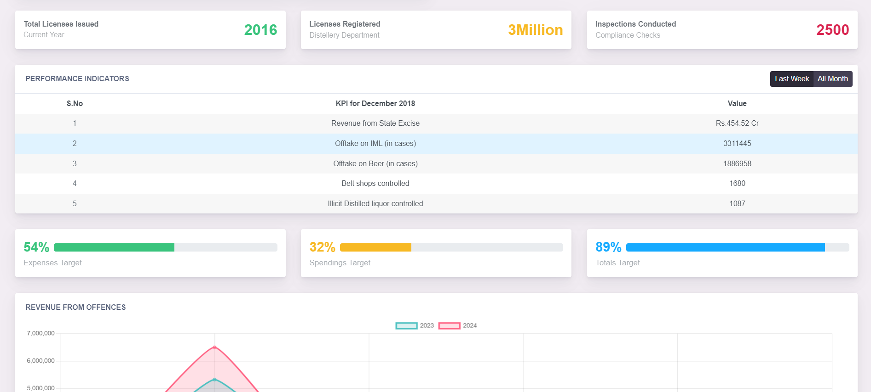
Excise metrics
dashboard

Slide 16
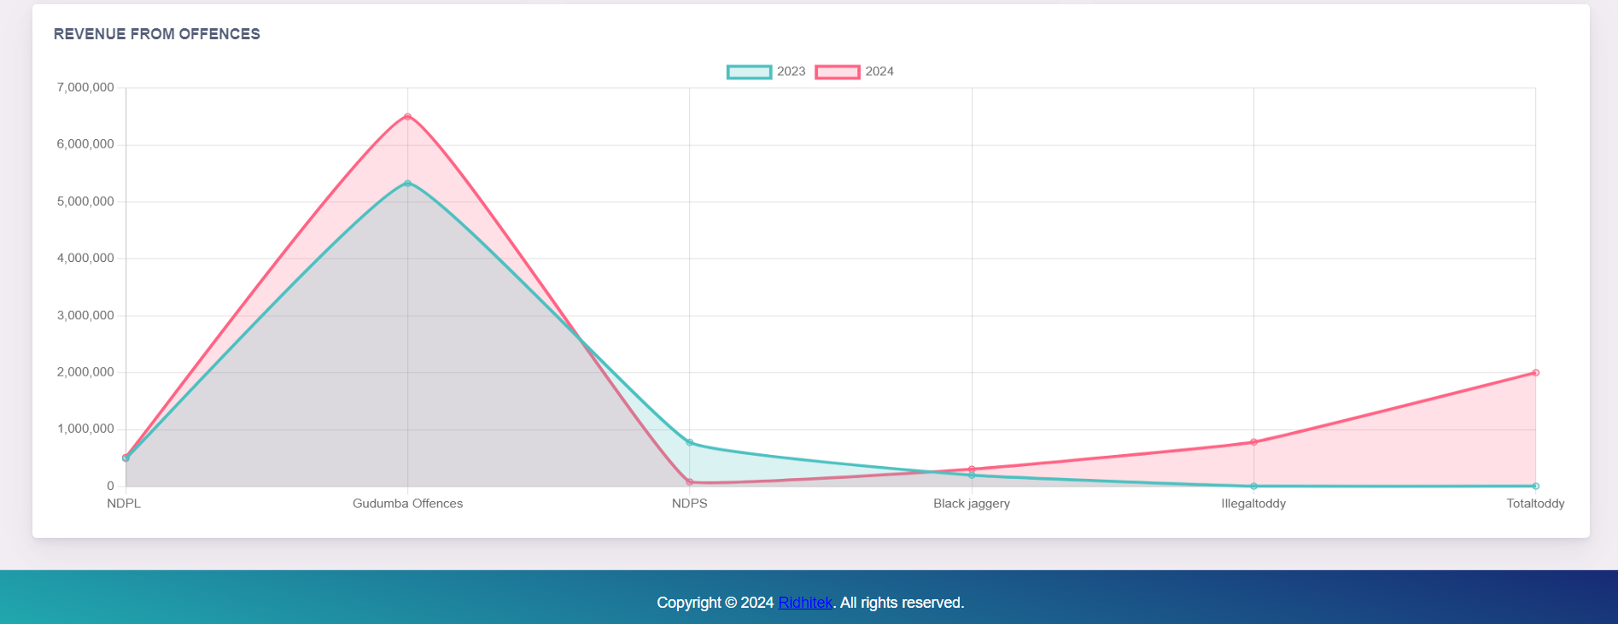
Revenue offences

Slide 17
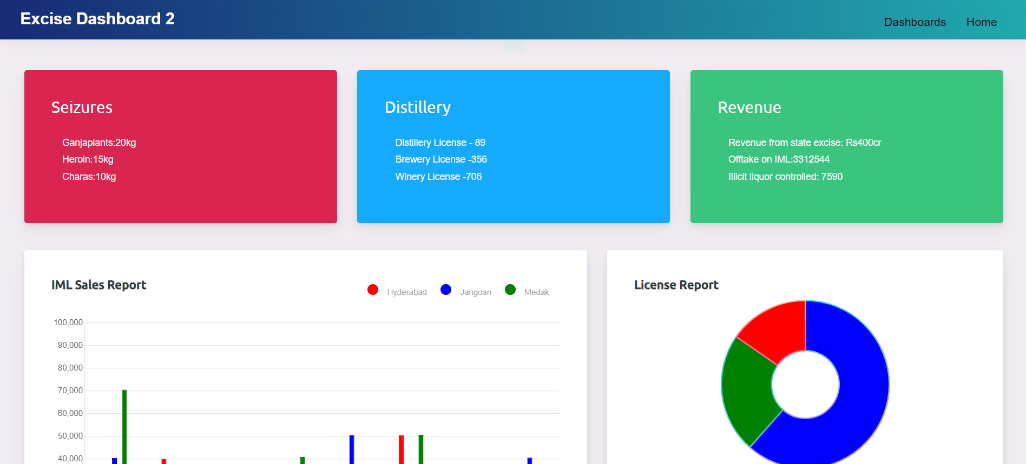
Excise department
overview

Slide 18
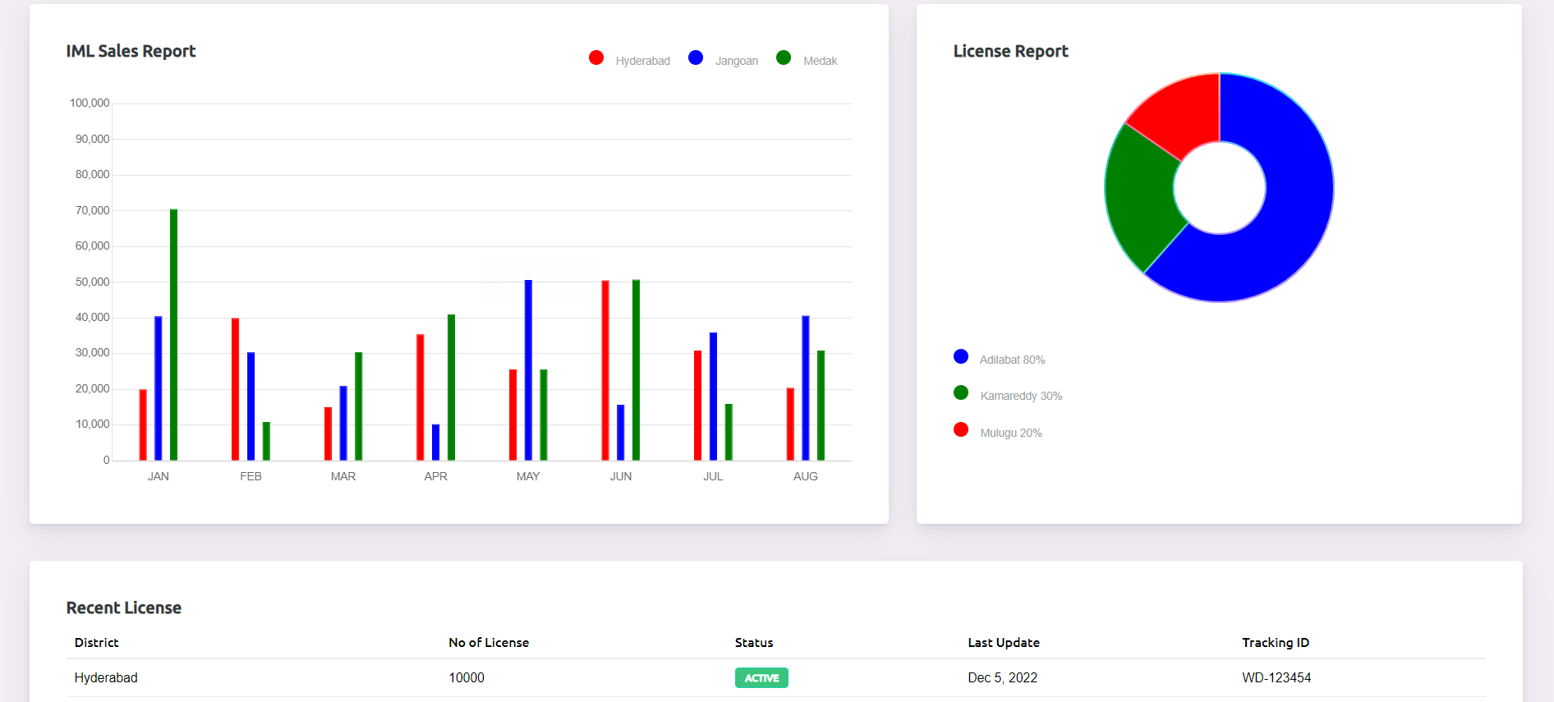
Excise sales report

Slide 19
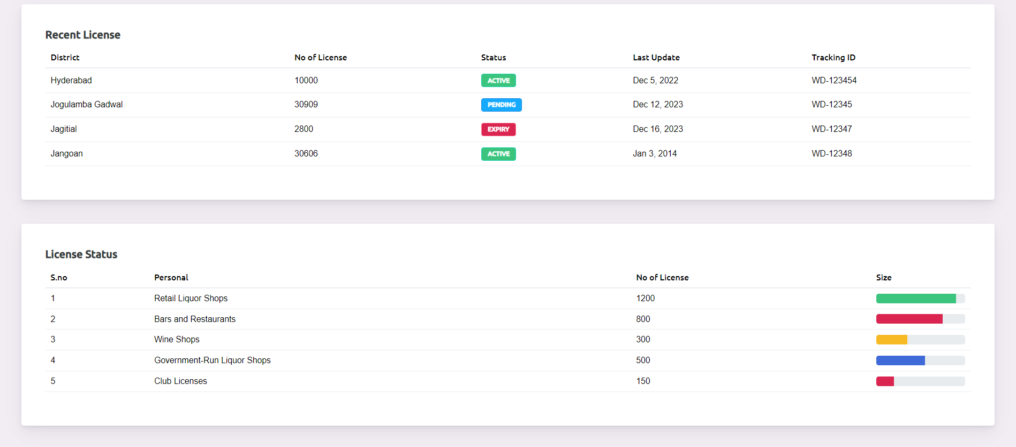
License status

Slide 20
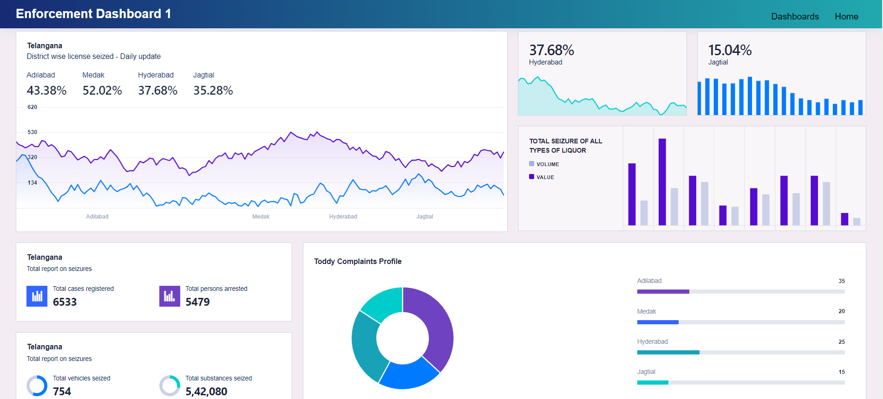
License seize report

Slide 21
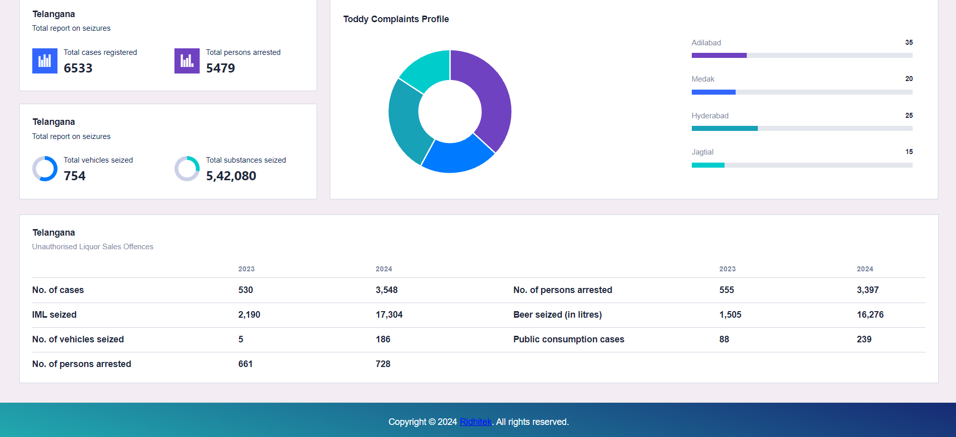
Overview of license
report

Slide 22
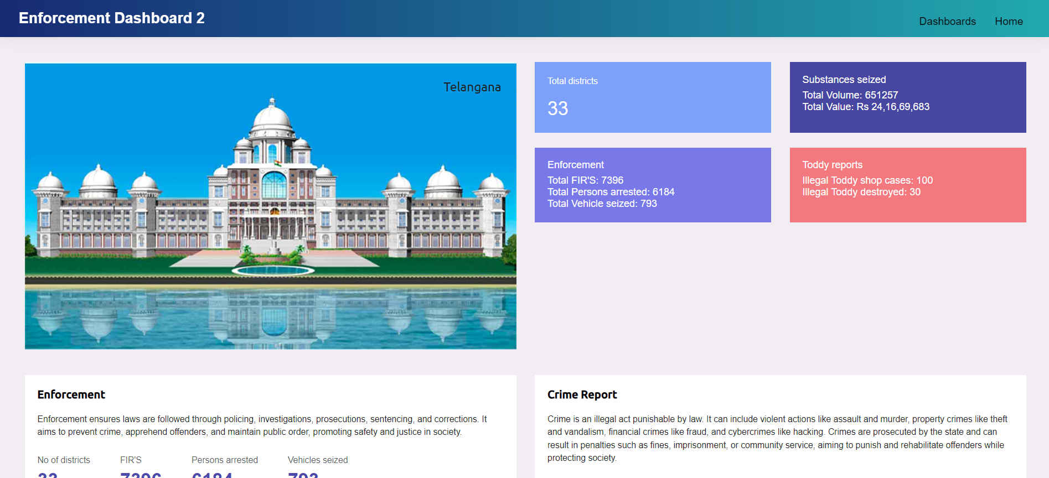
Overview Enforcement
Dashboard

Slide 23
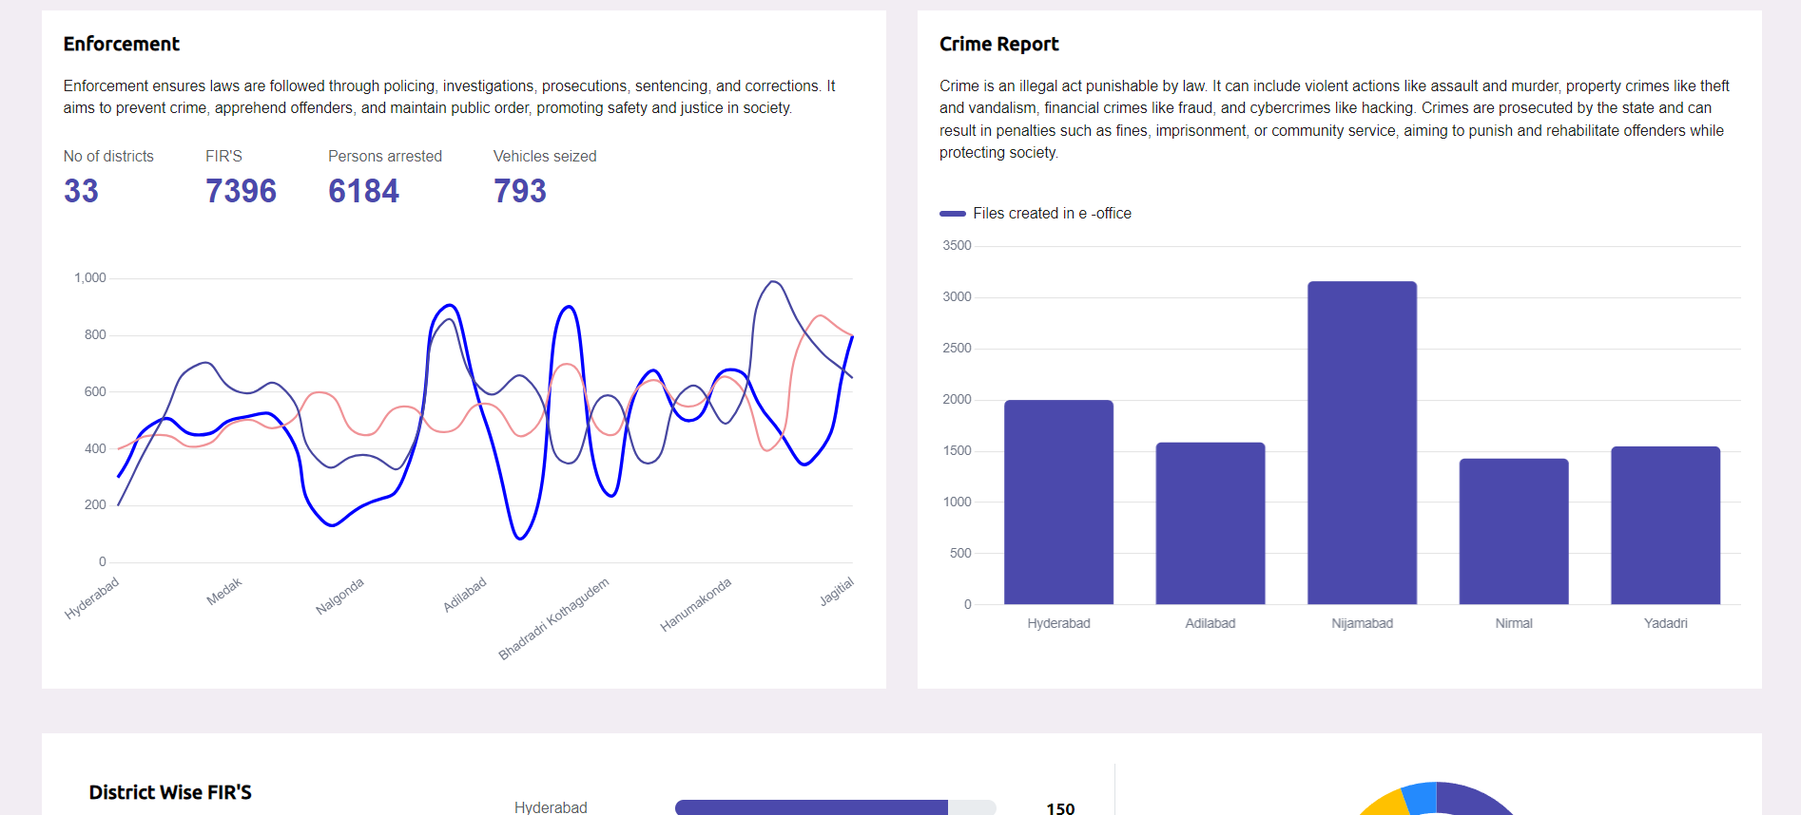
Enforcement crime
report

Slide 24
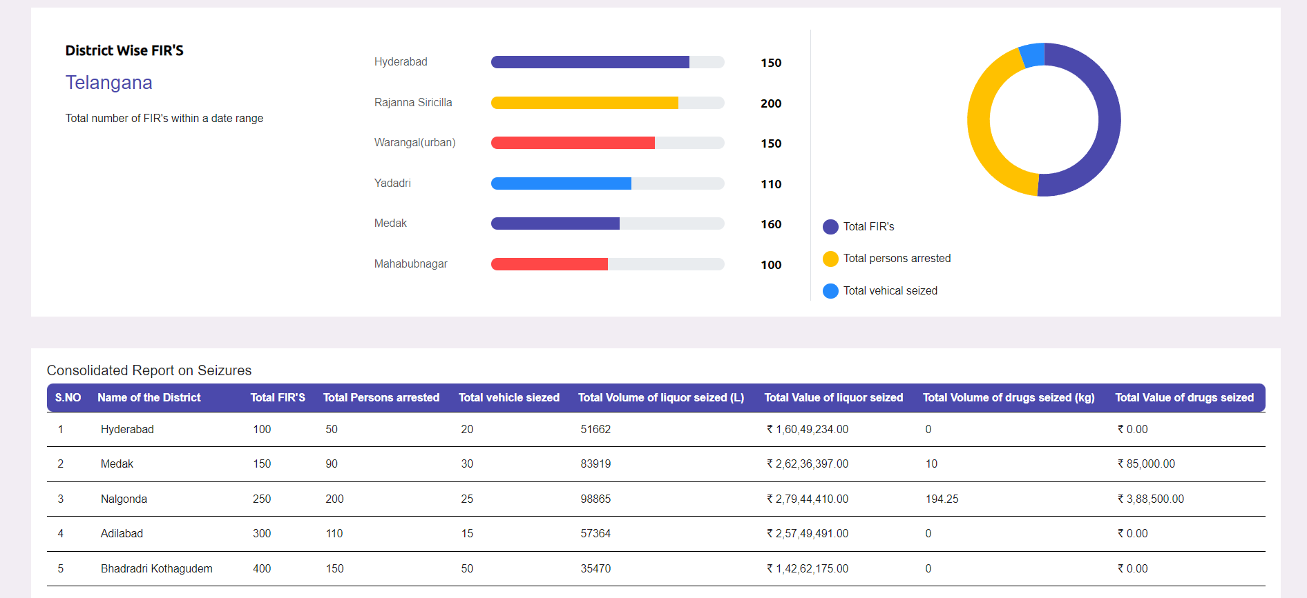
District wise FIR’S Report

Slide 25
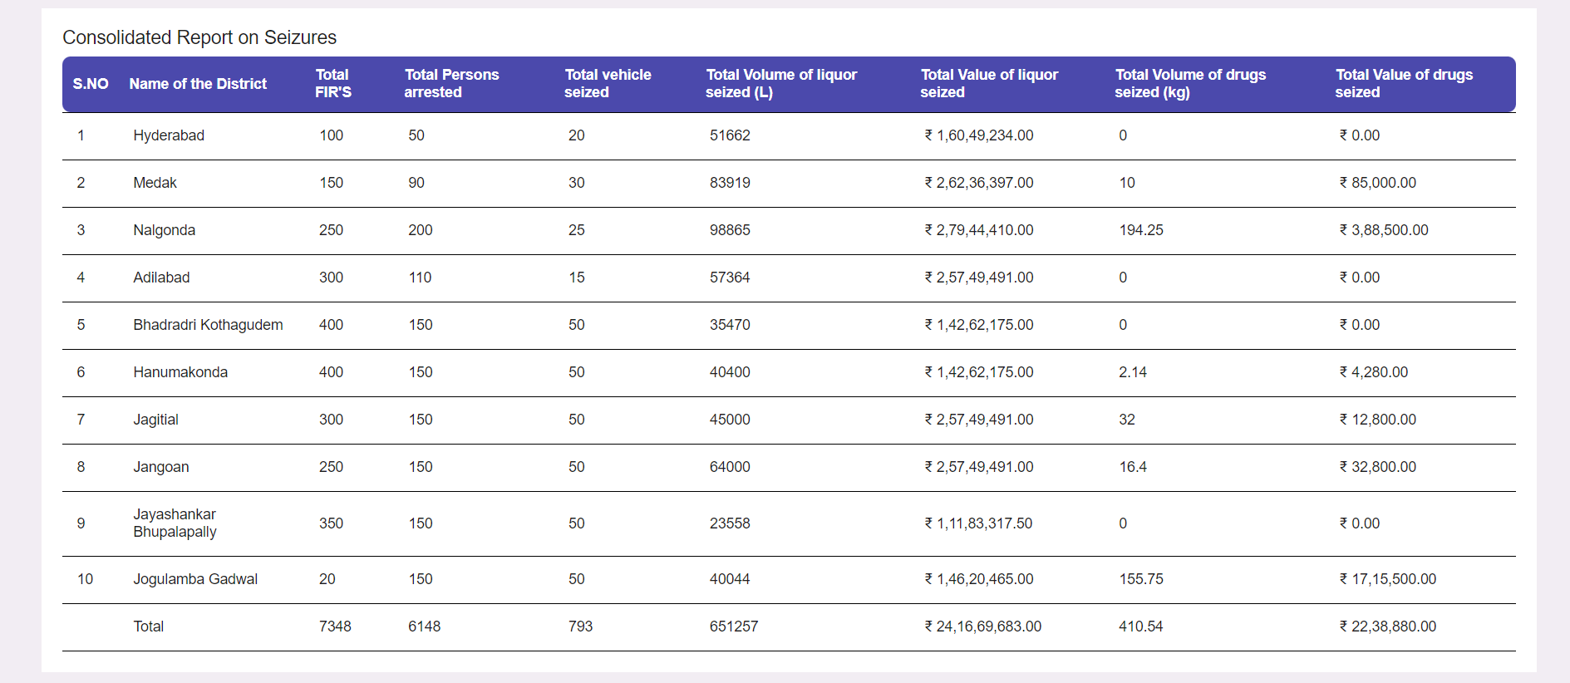
Report for license
seize

Slide 26
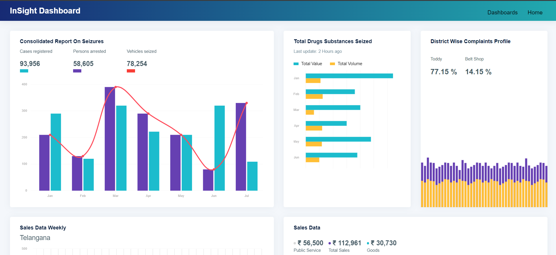
Consolidated reports on
seizures

Slide 27
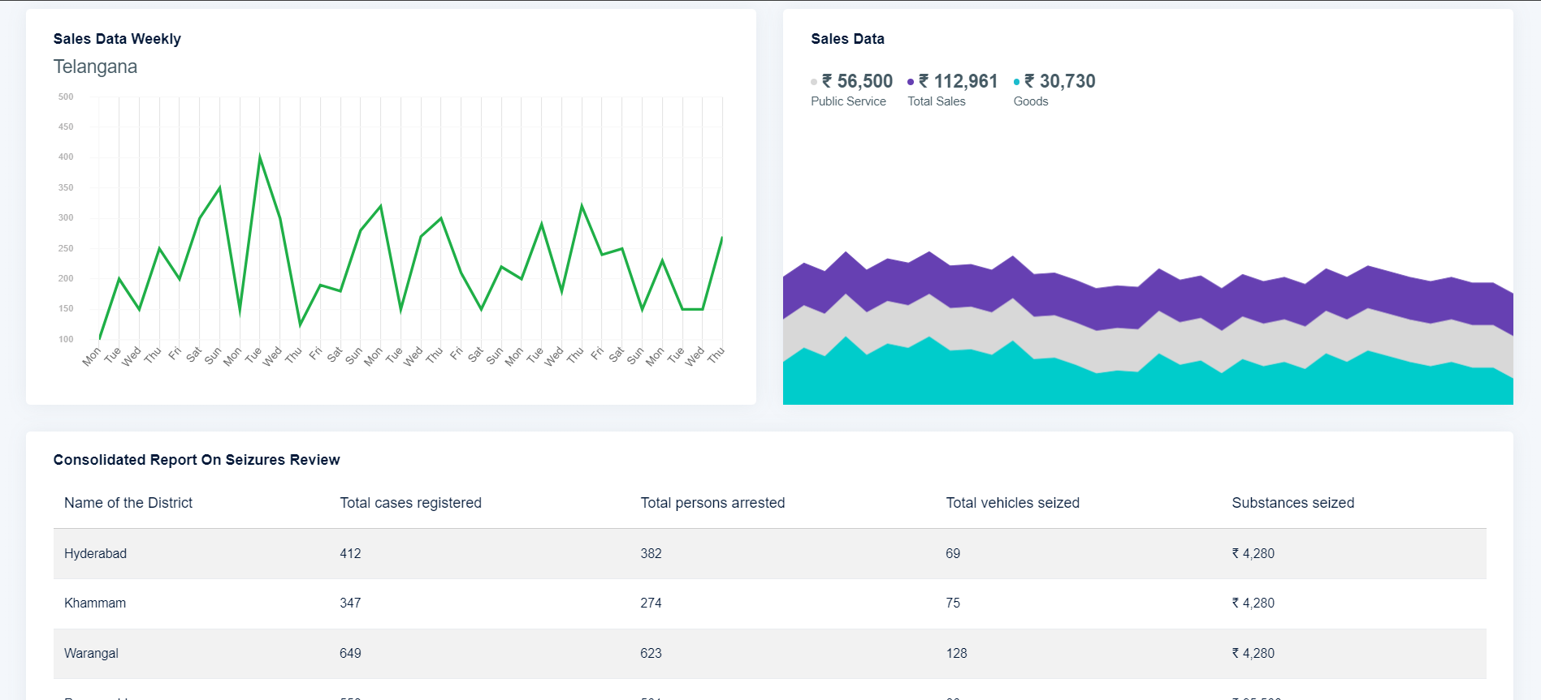
Reports for sales data

Slide 28
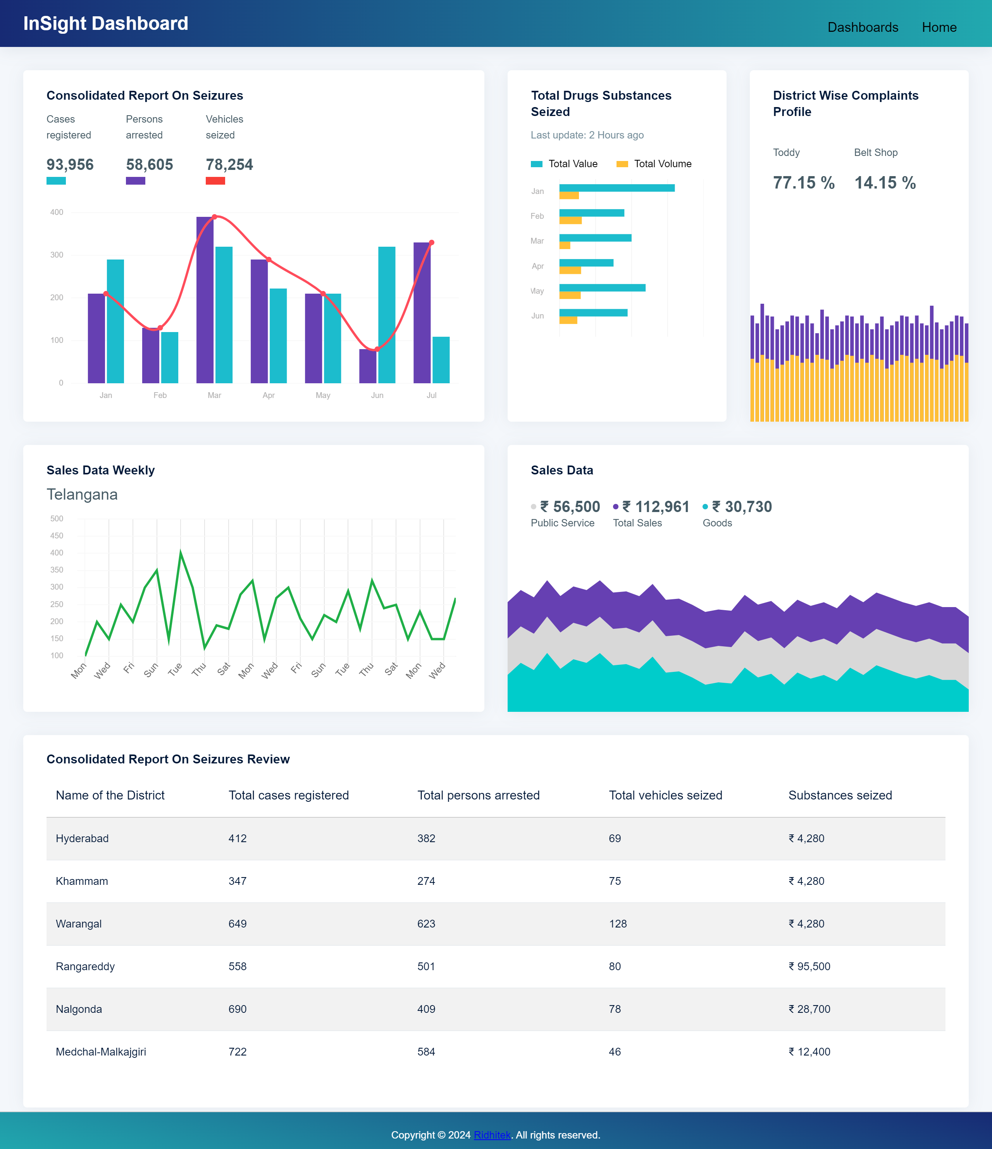
Consolidated report on
Seizures review

